Slide 1
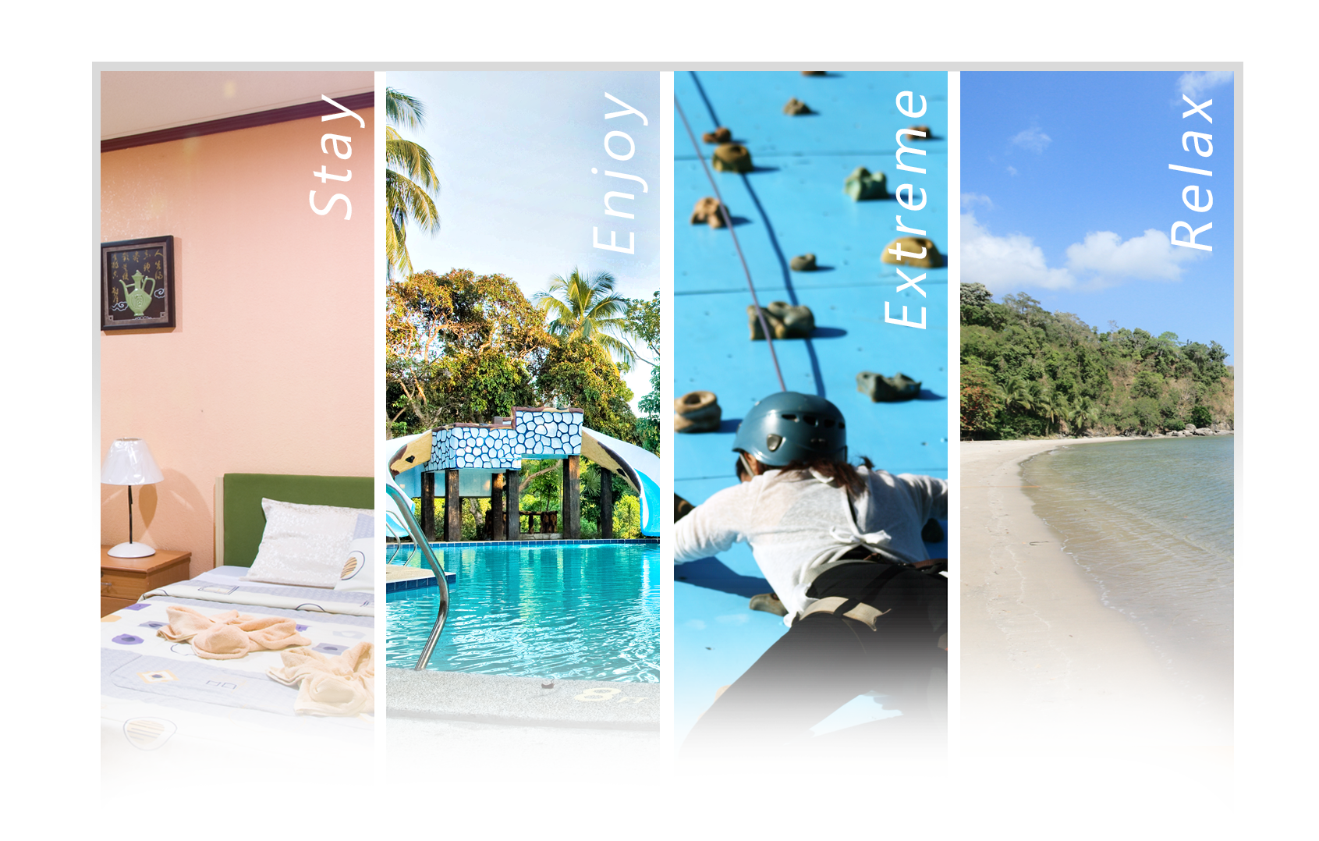
Marivic S. Collantes
Reservation & Marketing Officer
Tel: 8 373-5052
Mobile: 0921-8998271
Email add:vistaveniceresorts@yahoo.com
Website: www.vistavenice.com.ph

Slide 2
Sitio Marucdoc, Brgy. Nagbalayong, Morong Bataan
Manila Office: Rm M07, Prince Jun Condominium, 42 Timog Ave. Quezon City
Mobile No: 0921-8998271 Tel: 8 373-5052
Website: www.vistavenice.com.ph | Email: vistaveniceresorts@yahoo.com
Dear Sir / Madam,
It is our utmost pleasure to offer our resort as possible venue for your Company, Government, and School or Organizational activities like outing, Conference, Team Building Activities, Fellowships, Trainings and Christmas party.
About the Company
Vista Venice Resorts established in June of 2008, tuck into the base of mountain and enclosed by lush tropical countryside. Vista Venice Resorts is a treasure of unparalleled beauty. A magnificent 12-hectare resort, it is perfect for enjoying the day, whether lounging in their pools, playing a sport or two in their well-made sports area or gazing at the breathtaking views of the surrounding virgin mountains. Spend the night, taking a dip in their hot or cold Jacuzzis, strolling along their beautifully-landscaped path walks or lolling in their elegant and comfortable bedrooms. Vista Venice Resorts is a little more than two hours drive from Metro Manila lying in the infamous province of the last World War known as Bataan. Mention its name and instantly what comes to mind are the gallant Filipino-American soldiers who fought decisive battles against the Japanese Imperial Forces and the honors of their forced march- a symbol of democracy and freedom that will forever be etched in the annals of World history. But of course, Bataan has something more than its share of significance in History.
Our Mission
Vista Venice Resorts mission is to provide Guests with utmost “WOW” experience and bring the nature’s haven to everyone that is seeking a blissful facade of recreation and relaxation.
Our Vision
A pioneering, fun-filled nature resort that Encourages everyone to experience nature’s beauty while being pampered and relaxing into the resort’s unique features.

Slide 3
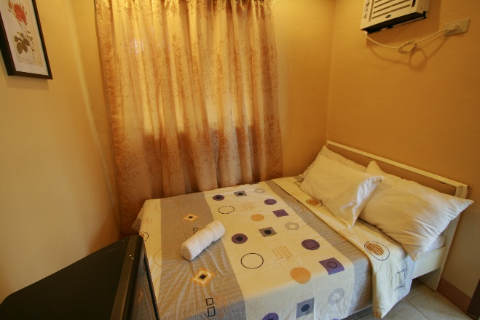
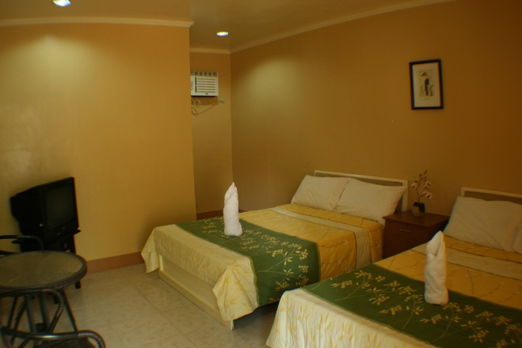
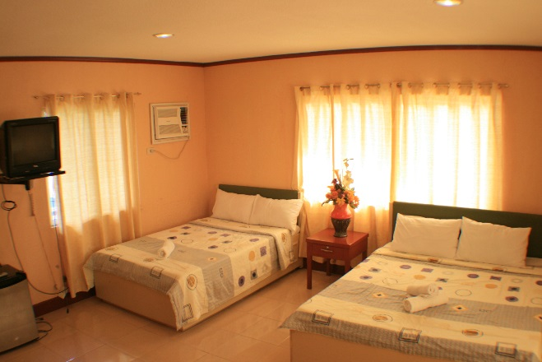
Sitio Marucdoc, Brgy. Nagbalayong, Morong Bataan
Manila Office: Rm M07, Prince Jun Condominium, 42 Timog Ave. Quezon City
Mobile No: 0921-8998271 Tel: 02 416-2870; 373-5052
Website: www.vistavenice.com.ph | Email: sales@vistavenice.com.ph
VISTA VENICE OVERNIGHT ACCOMMODATION
“Our resort offers fully air-conditioned rooms complete with Colored TV, Cable Channels, Private Bathroom with hot & cold shower”
*Off Peak Months: January 15 – February 28 | June 16 – November 15
*Peak Months: March 1 – June 15 | November 16 – January 14 | Long Week & Holidays
Note: Beach is 10 to 15 minute drive away from the resort.
Two (2) Couples Rooms – Tulip 3 & 4
(Lean Rate) ₱2,750.00
(Peak Rate) ₱2,900.00
One (1) Double size bed
Good for two (2) persons
With complimentary breakfast for two (2) persons
Air-conditioning
Cable TV
Comfort Room with Hot/Cold shower
Free toiletries
Free two (2) bottled water
Six (6) Deluxe Room - Jasmine 1 to 6
(Lean Rate) ₱4,500.00
(Peak Rate) ₱4,950.00
Two (2) Double size bed
Good for four (4) persons
With complimentary breakfast for four (4) persons
Air-conditioning
Cable TV
Comfort Room with Hot/Cold shower
Free toiletries
Free four (4) bottled water
Four (4) Premier Rooms – Rose 1 to 4
(Lean Rate) ₱5,000.00
(Peak Rate) ₱5,500.00
One (1) Queen size bed & One (1) Double size bed
Good for four (4) persons
Maximum of five (5) persons in a room with charge of P750 (Lean) / P950 (Peak) for the 5th person with breakfast
With complimentary breakfast for four (4) persons
Air-conditioning
Cable TV
Mini refrigerator
Comfort Room with Hot/Cold shower
With balcony
Free toiletries
Free four (4) bottled water

Slide 4
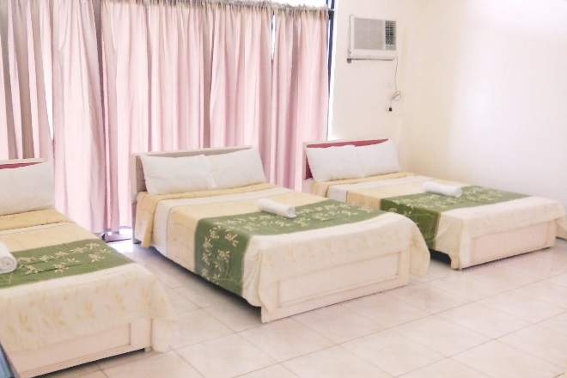
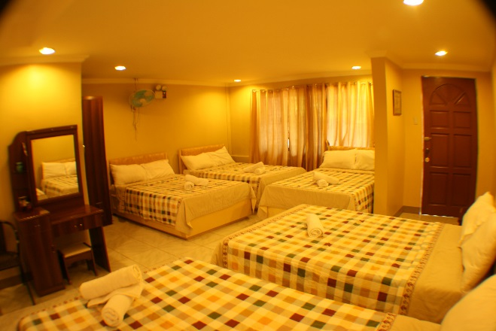
Sitio Marucdoc, Brgy. Nagbalayong, Morong Bataan
Manila Office: Rm M07, Prince Jun Condominium, 42 Timog Ave. Quezon City
Mobile No: 0921-8998271 Tel: 02 425-3004; 373-5052
Website: www.vistavenice.com.ph | Email: sales@vistavenice.com.ph
Five (5) De Luxe Mountain View – Cherry Blossom 1 to 5
(Lean Rate) ₱5,000.00
(Peak Rate) ₱5,950.00
Three (3) Double size bed
Good for four (4) persons
Maximum of six (6) persons in a room with charge of P750 (Lean) / P950 (Peak) for the 5th & 6th person with breakfast
With complimentary breakfast for four (4) persons
Air-conditioning
Cable TV
Comfort Room with Hot/Cold shower
Free toiletries
Free four (4) bottled water
Thirteen (13) Superior Rooms – Iris 1 to 4; Daisy 1 to 3; Orchid 1 to 3; Magnolia 1 to 3
(Lean Rate) ₱5,500.00
(Peak Rate) ₱5,950.00
Five (5) Double size bed
Good for five (5) persons
Maximum of ten (10) persons in a room with charge of P750 (Lean) / P950 (Peak) for the 6th to 10th person with breakfast
With complimentary breakfast for five (5) persons
Air-conditioning
Cable TV
Comfort Room with Hot/Cold shower
Free toiletries
Free five (5) bottled water
Twelve (12) Dormitory Rooms – Lily 1 to 12
(Lean Rate) ₱4,500.00
(Peak Rate) ₱4,900.00
Three (3) Double deck & One (1) single bed
Good for five (5) persons
Maximum of seven (7) persons in a room with charge of P750 (Lean) / P950 (Peak) for the 6th & 7th person with breakfast
With complimentary breakfast for five (5) persons
Air-conditioning
Cable TV
Comfort Room with Hot/Cold shower
Free toiletries
Free five (5) bottled water

Slide 5
Sitio Marucdoc, Brgy. Nagbalayong, Morong Bataan
Manila Office: Rm M07, Prince Jun Condominium, 42 Timog Ave. Quezon City
Mobile No: 0921-8998271Tel: 02 425-3004; 373-5052
Website: www.vistavenice.com.ph | Email: sales@vistavenice.com.ph
GROUP DAY TOUR PACKAGES
“This Summer, experience our Mountain Resort! With Managed Buffet Meals and Extra Snacks & Drinks!”
Day Tour Package
PHP 999.00 / Head
Resort Entrance
One Managed Buffet Lunch
Two Managed Buffet Snacks
Free use of amenities (Swimming Pool, Basketball Court, Billiards)
Use of Cottage – 1,500 (20-30pax)
Use of Griller – 350 with one (1) plastic bag of charcoal
GROUP OVERNIGHT PACKAGES
“ This Summer, experience Extreme Outdoor Sports and Summer Game Competitions right from a Mountain Resort terrain! Fully-Air Conditioned Overnight Accommodations and Managed Buffet Meals with Extra Snacks & Drinks! ”
Overnight Package no. 1
PHP 2,150.00 / Head
Resort Entrance
Room Accommodation
One Managed Buffet Lunch
One Managed Buffet Dinner
One Managed Buffet Breakfast
Free use of amenities (Swimming Pool, Basketball Court, Billiards)
Overnight Package no. 2
PHP 2,450.00 / Head
Resort Entrance
Room Accommodation
Two Managed Buffet Lunch
One Managed Buffet Dinner
One Managed Buffet Breakfast
Free use of amenities (Swimming Pool, Basketball Court, Billiards)

Slide 6
Sitio Marucdoc, Brgy. Nagbalayong, Morong Bataan
Manila Office: Rm M07, Prince Jun Condominium, 42 Timog Ave. Quezon City
Mobile No: 0921-8998271Tel: 8 373-5052
Website: www.vistavenice.com.ph | Email: vistaveniceresorts@yahoo.com
Overnight Package no. 3
PHP 2,750.00 / Head
Resort Entrance
Room Accommodation
Two Managed Buffet Lunch
One Managed Buffet Dinner
One Managed Buffet Breakfast
One Managed Buffet Snack
Use of Function Hall (8hours)
Free use of amenities (Swimming Pool, Jacuzzi, Basketball Court, Billiards)
Use of Team Building Facilities
Overnight Package no. 4
PHP 2,950.00 / Head
Resort Entrance
Room Accommodation
Two Managed Buffet Lunch
One Managed Buffet Dinner
One Managed Buffet Breakfast
One Managed Buffet Snack
Use of Function Hall (8hours)
Free use of amenities (Swimming Pool, Jacuzzi, Basketball Court, Billiards)
Use of Team Building Facilities
Team Building Facilitator
Overnight Package no. 5
PHP 3,200.00 / Head
Resort Entrance
Room Accommodation Two Managed Buffet Lunch
One Managed Buffet Dinner
One Managed Buffet Breakfast
One Managed Buffet Snack
Use of Function Hall (8hours)
Free use of amenities (Swimming Pool, Jacuzzi, Basketball Court, Billiards)
Teambuilding with Facilitator
Choose One (1) Extreme Sports (Zipline or Rapelling or Wall-Climbing)

Slide 7
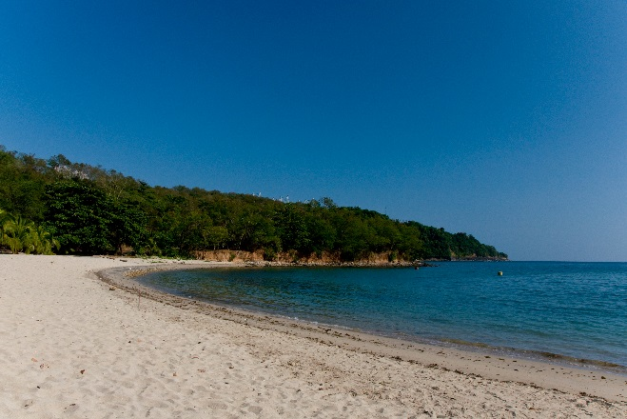
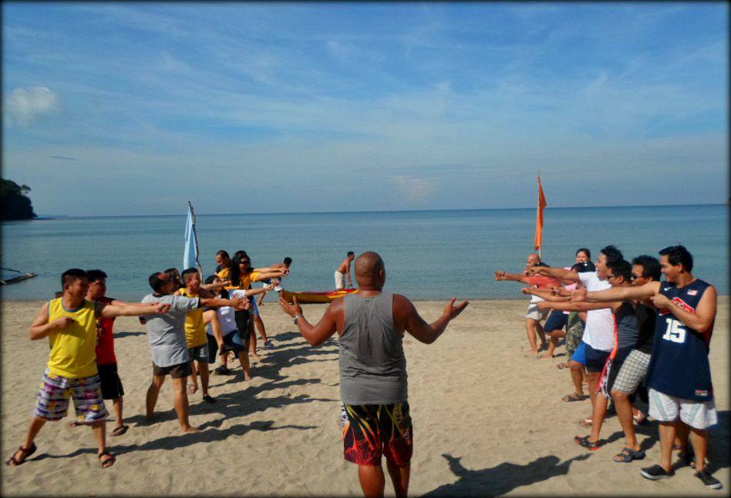
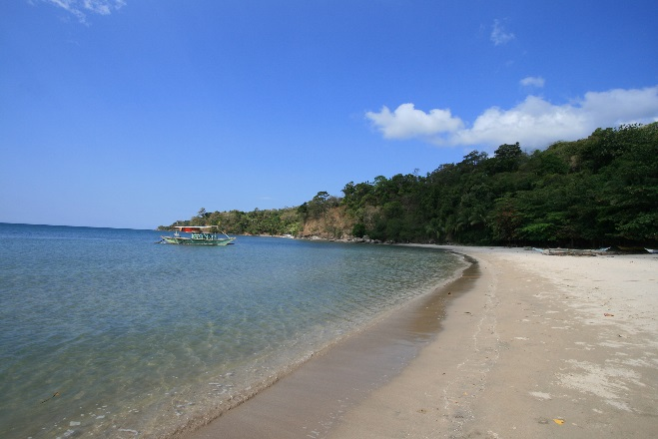
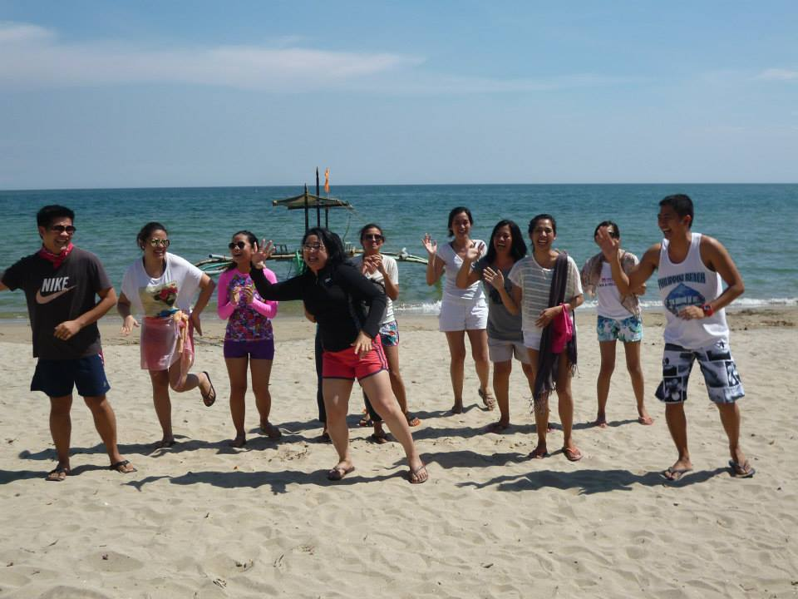
Sitio Marucdoc, Brgy. Nagbalayong, Morong Bataan
Manila Office: Rm M07, Prince Jun Condominium, 42 Timog Ave. Quezon City
Mobile No: 0921-8998271Tel: 02 425-3004; 373-5052
Website: www.vistavenice.com.ph | Email: sales@vistavenice.com.ph
BEACH
“Beach is the best way to experience in Bataan, Its only 10 to 15 minutes away from the affiliated Vista Venice Highland Resort”
Westnuk Beach Cove
PHP 200.00 / Head with use of cottage
The Westnuk Beach Cove. An executive cove situated at the Bataan Nuclear Power Plant Complex. There are separate shower rooms & toilets. With various enjoyable outdoor activities.
Looc Beach
PHP 100.00 / Head - use of cottage: Php 1,000 Good for 10 pax
Enjoy and relax under the sun with fine and white sand, clear water and relaxing views of Looc Beach.

Slide 8
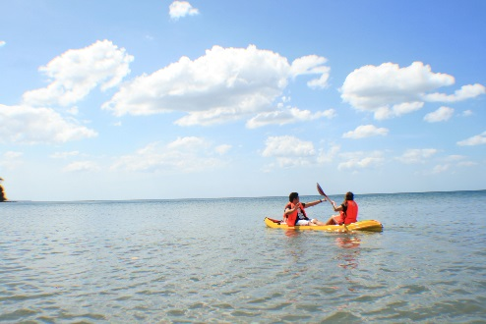
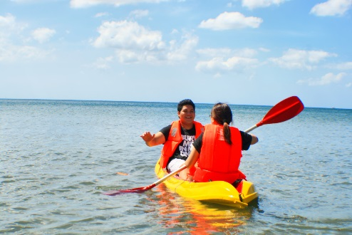
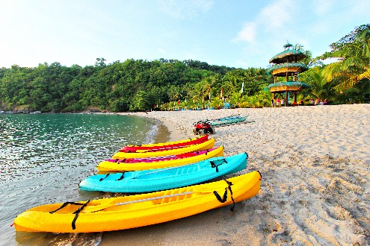
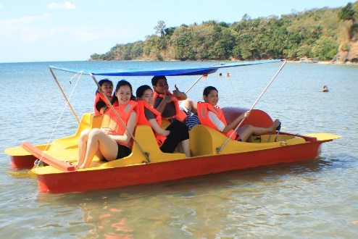
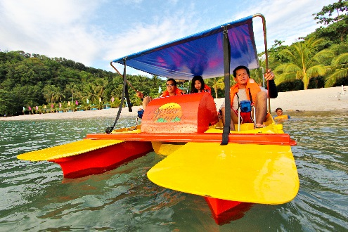
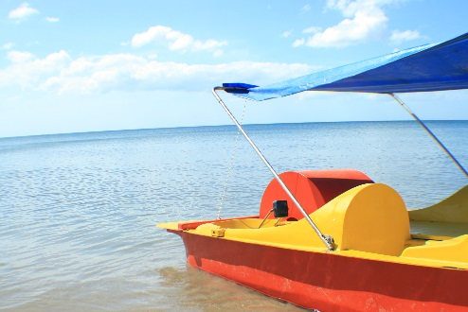
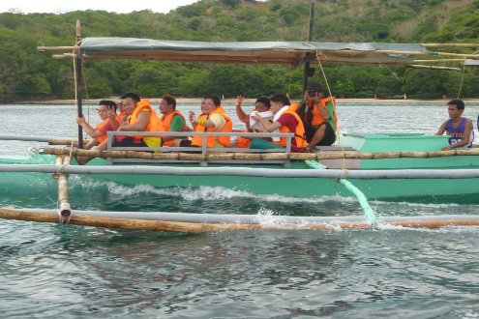
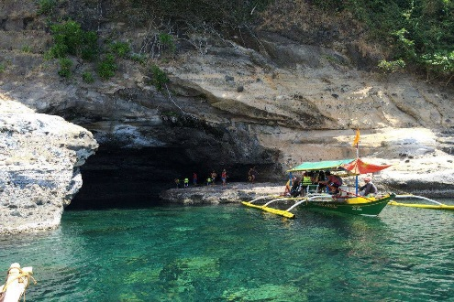
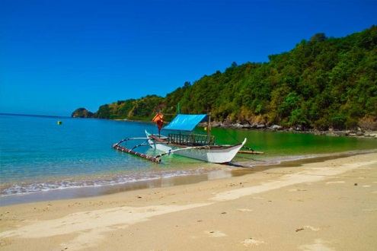
Sitio Marucdoc, Brgy. Nagbalayong, Morong Bataan
Manila Office: Rm M07, Prince Jun Condominium, 42 Timog Ave. Quezon City
Mobile No: 0921-8998271Tel: 02 425-3004; 373-5052
Website: www.vistavenice.com.ph | Email: sales@vistavenice.com.ph
WATER SPORTS ACTIVITIES
“Fun under the sun with Water Sports Activities at White Sand & Crystal Clear Water of the Beach!”
Kayak
(Single) PHP 250.00 / Hour
(Double) PHP 550.00 / Hour
Aqua Bike
PHP 800.00 / 30 Mins.
Island Hopping Boat
PHP 2,300.00 / 12 Persons

Slide 9
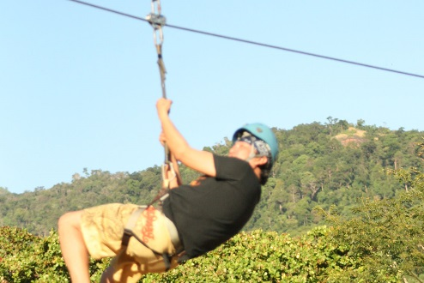
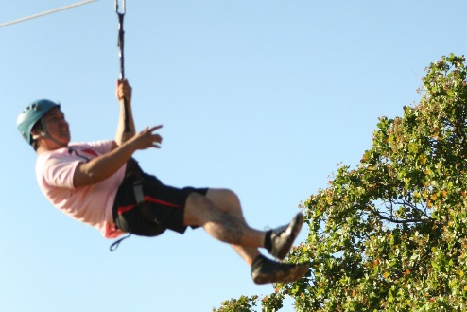
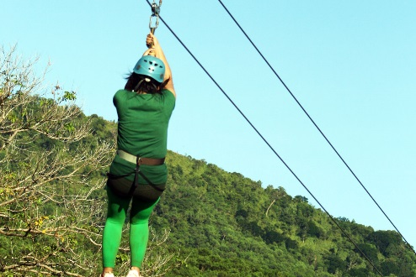
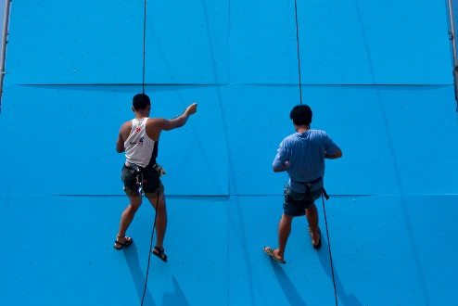
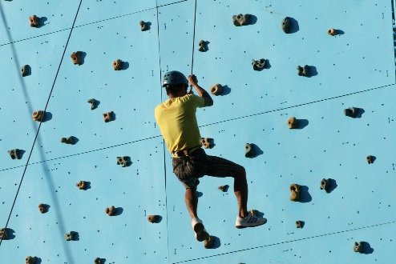
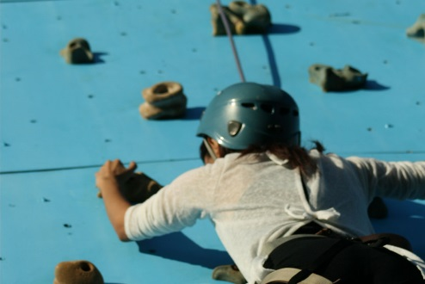
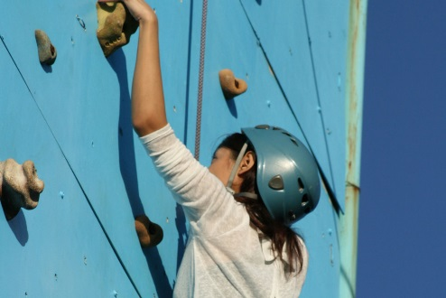
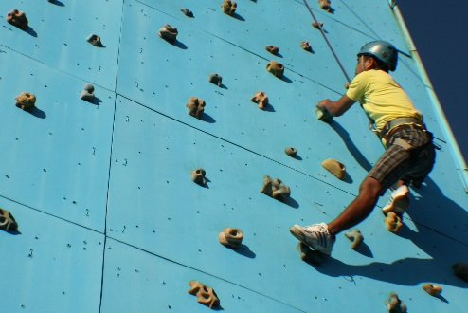
Sitio Marucdoc, Brgy. Nagbalayong, Morong Bataan
Manila Office: Rm M07, Prince Jun Condominium, 42 Timog Ave. Quezon City
Mobile No: 0921-8998271Tel: 02 416-2870; 373-5052
Website: www.vistavenice.com.ph | Email: sales@vistavenice.com.ph
EXTREME SPORTS
“Fun under the sun with extreme sports will definitely give you’re Group Teams an Exciting and Enjoyable Full-workout experience! Check-out our Extreme Adventure Facilities!”
Zip lining
PHP 250.00 / Person
Rappelling
PHP 250.00 / Person
Wall Climbing
PHP 250.00 / Person
*One (1) Round (Zip lining, Rappelling, Wall Climbing)
PHP 500.00 / Person

Slide 10
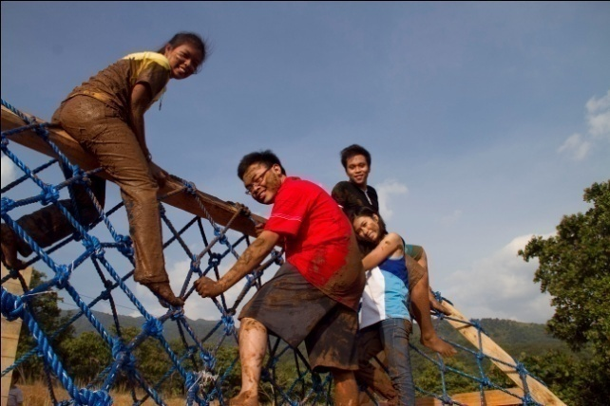
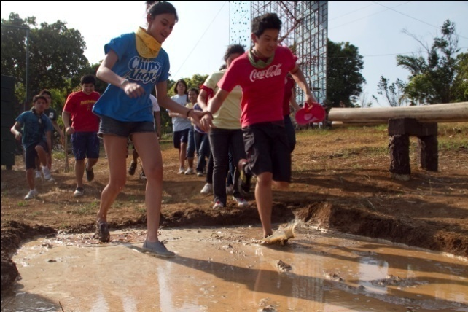
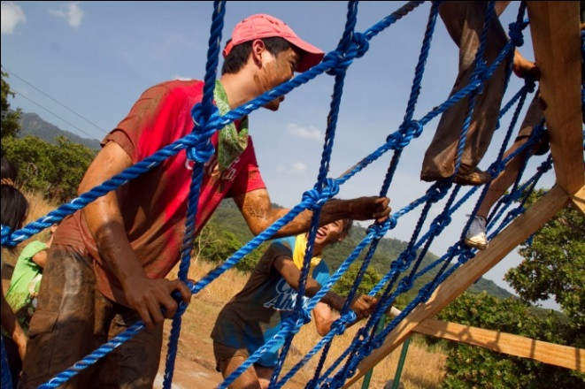
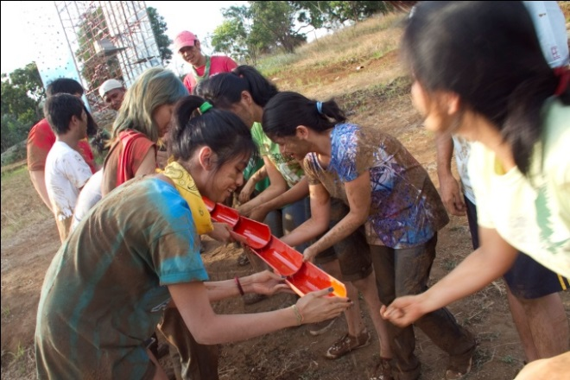
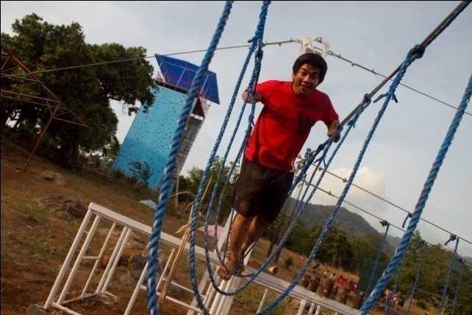
Sitio Marucdoc, Brgy. Nagbalayong, Morong Bataan
Manila Office: Rm M07, Prince Jun Condominium, 42 Timog Ave. Quezon City
Mobile No: 0921-8998271 Tel: 02 425-3004; 373-5052
Website: www.vistavenice.com.ph | Email: sales@vistavenice.com.ph
TEAM BUILDING FACILITIES
“Fun under the sun with team building facilities will definitely give you’re Group Teams an Exciting and Enjoyable Full-workout experience!

Slide 11
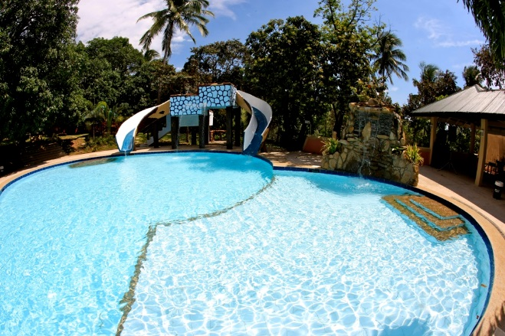
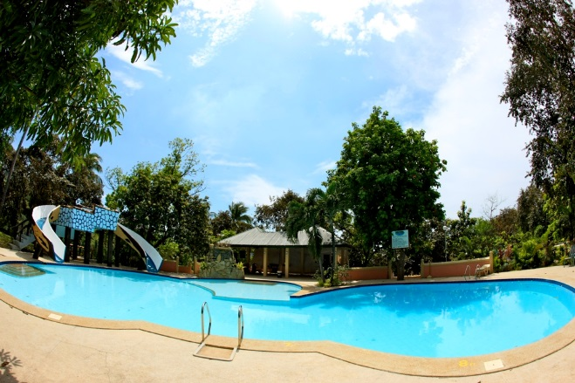
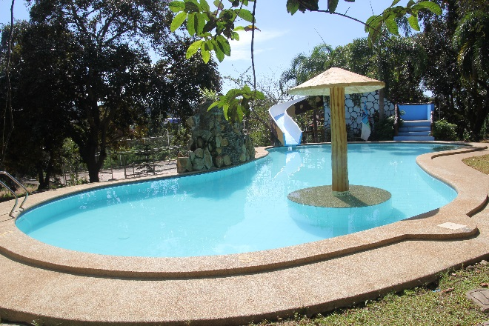
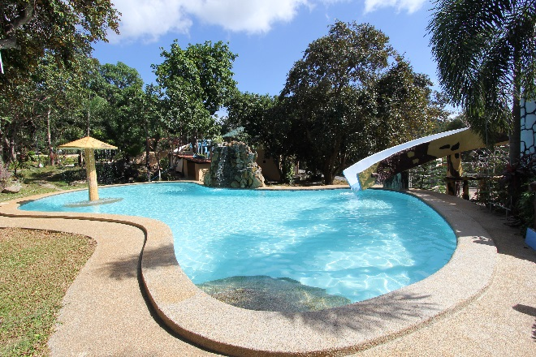
Sitio Marucdoc, Brgy. Nagbalayong, Morong Bataan
Manila Office: Rm M07, Prince Jun Condominium, 42 Timog Ave. Quezon City
Mobile No: 0921-8998271 Tel: 02 425-3004; 373-5052
Website: www.vistavenice.com.ph | Email: sales@vistavenice.com.ph
VISTA VENICE POOLS & JACUZZIS
“Guests of Vista Venice Resorts can take choices swimming on three (3) of our major “Fun in the Sun“ swimming pools. We designed our swimming pools equipped with splendid waterfalls splashing close the pools elongated slides. We also placed sun lounge chairs around the pool area, plus tables, chairs and umbrellas for guests who wants to lay their backs under the sun. Our pools also is a venue for aqua aerobic activities for special groups and functions (as per request ) More so, our pools can be a “bonding” venue not only of friends but also for families as its depth was planned not only for kids but also for adults.”
Adult Pool with Kiddie Pool
Teen Pool

Slide 12
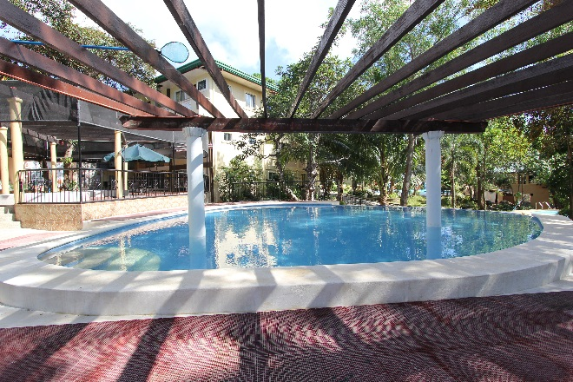
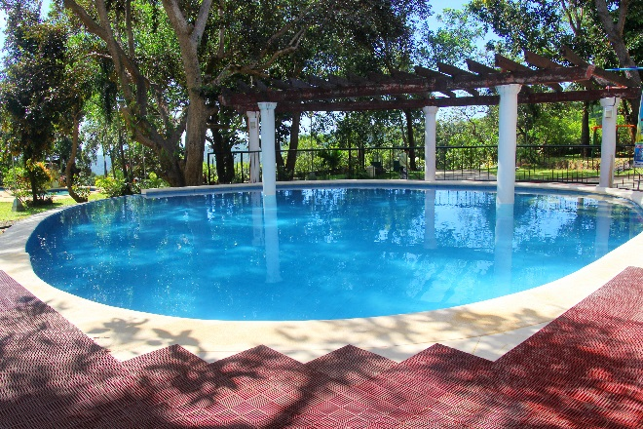
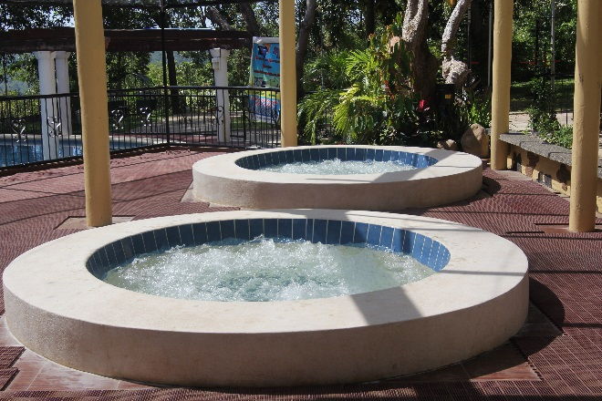
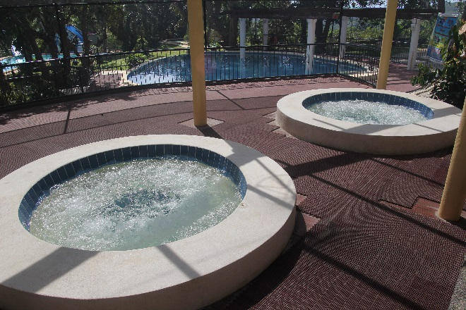
Sitio Marucdoc, Brgy. Nagbalayong, Morong Bataan
Manila Office: Rm M07, Prince Jun Condominium, 42 Timog Ave. Quezon City
Mobile No: 0921-8998271 Tel: 02 425-3004; 373-5052
Website: www.vistavenice.com.ph | Email: sales@vistavenice.com.ph
Infinity Pool
Jacuzzi

Slide 13
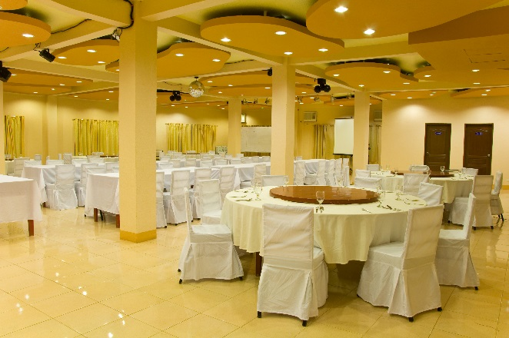
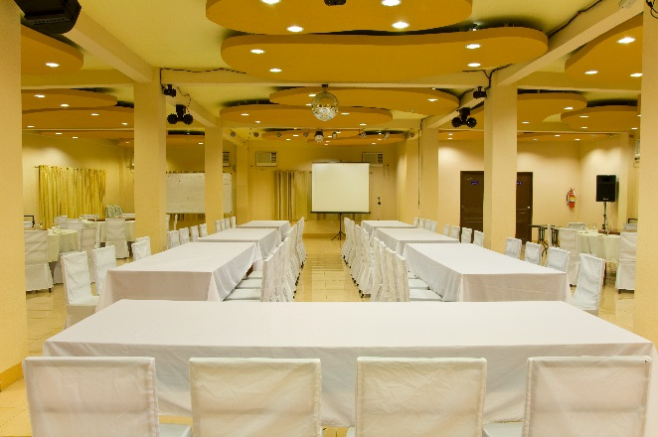
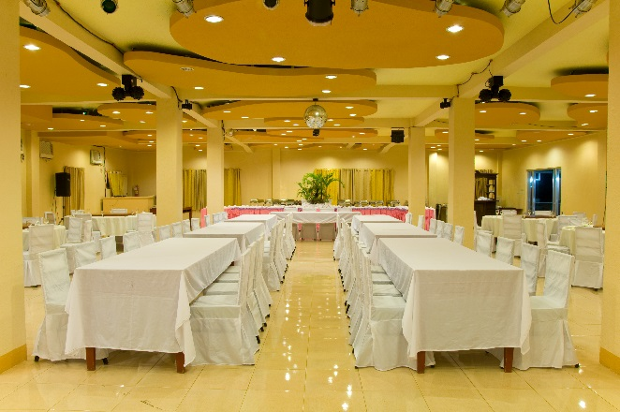
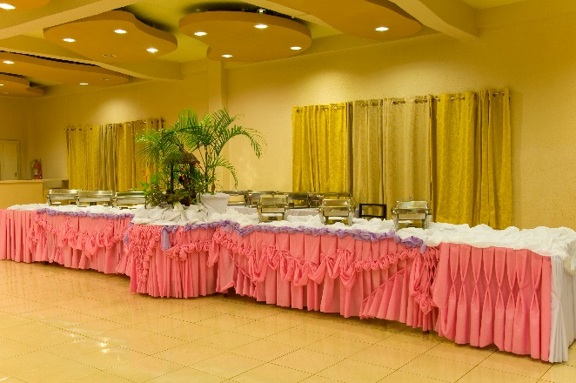
Sitio Marucdoc, Brgy. Nagbalayong, Morong Bataan
Manila Office: Rm M07Sitio Marucdoc, Brgy. Nagbalayong, Morong Bataan
Manila Office: Rm M07, Prince Jun Condominium, 42 Timog Ave. Quezon City
Mobile No: 0921-8998271 Tel: 02 425-3004; 373-5052
Website: www.vistavenice.com.ph | Email: sales@vistavenice.com.ph
VISTA VENICE CONFERENCE / FUNCTION HALL
“Our function halls can accommodate 100-250 persons, fully air-conditioned and equipped with
state-of-the-art amenities to meet the demands of any function.”

Slide 14
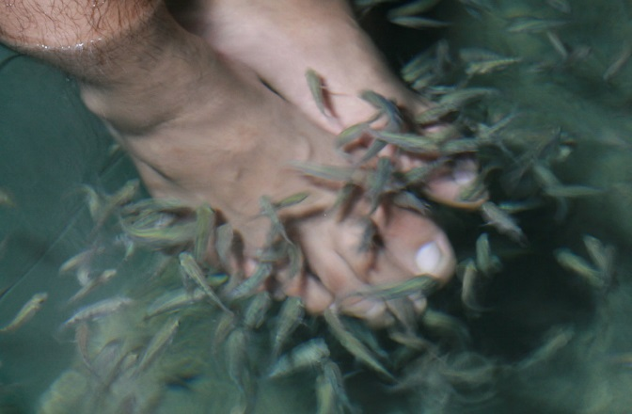
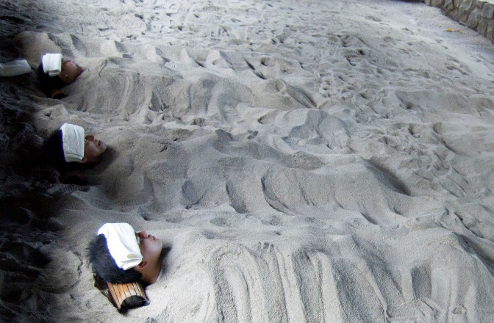
Sitio Marucdoc, Brgy. Nagbalayong, Morong Bataan
Manila Office: Rm M07, Prince Jun Condominium, 42 Timog Ave. Quezon City
Mobile No: 0921-8998271Tel: 02 425-3004; 373-5052
Website: www.vistavenice.com.ph | Email: sales@vistavenice.com.ph
VISTA VENICE SPA & MASSAGE
“Need to relax? We can take care of that. Resorts is known for your Volcanic Spa, the very first in the region. We also have the Doctor Fish Spa, Foot Spa and Body Massage, the treatment that can help promote healthy skin growth”
Full Body Massage
PHP 399.00
Try our very own signature massage (1 hour)
Foot Spa
PHP 250.00
Foot spa with scrub
Dr. Fish Spa
PHP 50.00
Fish therapy (30 mins.)
Volcanic Spa
PHP 350.00
The resort’s very own Volcanic Sand Spa (30 mins.)

Slide 15
Sitio Marucdoc, Brgy. Nagbalayong, Morong Bataan
Manila Office: Rm M07, Prince Jun Condominium, 42 Timog Ave. Quezon City
Mobile No: 0921-8998271Tel: 02 425-3004; 373-5052
Website: www.vistavenice.com.ph | Email: sales@vistavenice.com.ph
OUR CLIENTS
Government Offices
Department of Agriculture
Department of Environment and Natural Resources
Department of Health
Department of Labor and Employment
Department of Tourism
Department of the Interior and Local Government
National Telecommunications Commission
Department of Trade and Industry
Bureau of Corrections
Department of Social Welfare and Development
National Irrigation Administration
Commission on Higher Education
Securities and Exchange Commission
Department of Budget and Management
Department of Finance
Philippine Coconut Authority
Department of Foreign Affairs
Bureau of Fisheries and Aquatic Resources
Commission on Audit
National Power Corporation

Slide 16
Sitio Marucdoc, Brgy. Nagbalayong, Morong Bataan
Manila Office: Rm M07, Prince Jun Condominium, 42 Timog Ave. Quezon City
Mobile No: 0921-8998271Tel: 02 425-3004; 373-5052
Website: www.vistavenice.com.ph | Email: sales@vistavenice.com.ph
National Police Commission
Department of National Defense
Bataan Tourism Center
Philippine Coast Guard
Department of Agrarian Reform
Quezon City Government
Provincial Government of Bulacan
Manila City Hall
Provincial Government of Calamba
Provincial Government of Olongapo
Municipality of Mariveles
Philippine Health Insurance Corporation
Home Development Mutual Fund
Banko Sentral ng Pilipinas
Department of Education
Pasig River Rehabilitation Commission
Maritime Training Council
Batangas City Hall
Caloocan City Hall
San Lorenzo Ruiz Women’s Hospital

Slide 17
Sitio Marucdoc, Brgy. Nagbalayong, Morong Bataan
Manila Office: Rm M07, Prince Jun Condominium, 42 Timog Ave. Quezon City
Mobile No: 0921-8998271 Tel: 02 425-3004; 373-5052
Website: www.vistavenice.com.ph | Email: sales@vistavenice.com.ph
Schools / Universities
Mapua Institute of Technology
Miriam College
Polytechnic University of the Philippines
University of the Philippines
University of the East
St. Paul University
Our Lady of Fatima University
Don Honorio Ventura Technological State University
De La Salle College of Saint Benilde
STI College
Bulacan State University
Philippine Normal University
Universal College of Parañaque City
Manila Tytana Colleges
FEU Fern College
Institute of Integrated Electrical Engineers
University of Caloocan City
Philippine State College of Aeronautics
ACLC College
Quezon City Science High School

Slide 18
Sitio Marucdoc, Brgy. Nagbalayong, Morong Bataan
Manila Office: Rm M07, Prince Jun Condominium, 42 Timog Ave. Quezon City
Mobile No: 0921-8998271 Tel: 02 425-3004; 373-5052
Website: www.vistavenice.com.ph | Email: sales@vistavenice.com.ph
Private Offices
360 Fitness Club
Accenture
Anchor Collection Services, Inc.
APM Technica Adhesive & Surface Technology
Aviat Networks
Bonifacio Global City
Big Pix Graphic Systems
Chevron Corporation
Cloudstaff
Clark Water Corporation
Decopro Inc.
DMCI Homes
Elabram Systems
Feedmix Specialist Inc
Globe
Igloo Supply Chain
Kawasaki Motors
Manpower for Advertising Services Agency Inc.
Maersk.
Manila Doctors Hospital

Slide 19
VISTA VENICE CERTIFICATE AND PERMIT

Slide 20
Sitio Marucdoc, Brgy. Nagbalayong, Morong Bataan
Manila Office: Rm M07, Prince Jun Condominium, 42 Timog Ave. Quezon City
Mobile No: 0921-8998271 Tel: 02 425-3004; 373-5052
Website: www.vistavenice.com.ph | Email: sales@vistavenice.com.ph
VISTA VENICE MENU
Set Menu for Breakfast
SET A
Beef Tapa
Crispy Tawilis
Salted Egg with Tomato
Fried Rice
Coffee or Tea
SET B
Pork Tocino
Tinapa
Egg with Tomato & Onion
Fried Rice
Coffee or Tea
SET C
Longanisa
Fried Dilis with Tomato
Fried Egg
Fried Rice
Coffee or Tea
SET D
Corned Beef with Potato
Dried Fish (Tuyo)
Egg with Tomato & Onion
Fried Rice
Coffee or Tea

Slide 21
Sitio Marucdoc, Brgy. Nagbalayong, Morong Bataan
Manila Office: Rm M07, Prince Jun Condominium, 42 Timog Ave. Quezon City
Mobile No: 0921-8998271 Tel: 02 425-3004; 373-5052
Website: www.vistavenice.com.ph | Email: sales@vistavenice.com.ph
Set Menu for PM Snack
SET A
Pancit Guisado / Toasted Bread / Iced Tea
SET B
Lomi / Bread or Puto / Iced Tea
SET C
Spaghetti with Meat Sauce / Sliced Bread / Iced Tea
Set Menu for AM Snack
SET A
Goto or Aroscaldo / Tokwa’t Baboy / Iced Tea
SET B
Chicken Sandwich / Iced Tea
SET C
Tuna Sandwich / Iced Tea

Slide 22
Sitio Marucdoc, Brgy. Nagbalayong, Morong Bataan
Manila Office: Rm M07, Prince Jun Condominium, 42 Timog Ave. Quezon City
Mobile No: 0921-8998271Tel: 02 425-3004; 373-5052
Website: www.vistavenice.com.ph | Email: sales@vistavenice.com.ph
Set Menu for Lunch and Dinner
SET A
Chicken & Corn Soup
Grilled Chicken
Sweet & Sour Fish
Chopsuey
Steamed Rice
Buko Pandan
Iced Tea
SET B
Cream of Mushroom
Fried Chicken
Sweet & Sour Pork
Eggplant with Minced Pork
Steamed Rice
Gelatine
Iced Tea
SET C
Asparagus Soup
Beef with Brocoli
Spicy Chicken
Seafood's Mixed Vegetables
Steamed Rice
Fruit in Season
Iced Tea
SET D
Shrimp Chowder Soup
Lemon Chicken
Spicy Pork Spareribs
Mixed Vegetables
Steamed Rice
Almond Jelly
Iced Tea
SET E
Misua Soup
Fried Salmon
Pork Asado
Pakbet
Steamed Rice
Fruit in Season
Iced Tea
SET F
Sinigang Soup
Inihaw na Liempo
Spicy Squid
Steamed Vegetables
Steamed Rice
Sweet Potato
Iced Tea

